Slide 1


Park and Pay
By Hackathon team Hugs for Bugs
Team -
Venkatesh
Yafei
Xiaoqi
Sachin

Slide 2
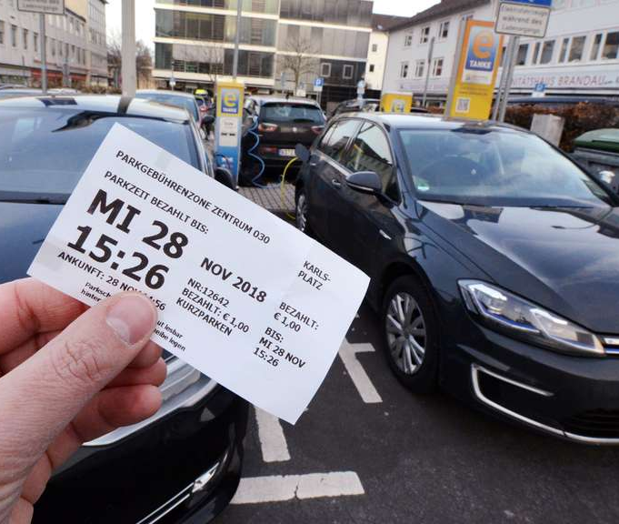

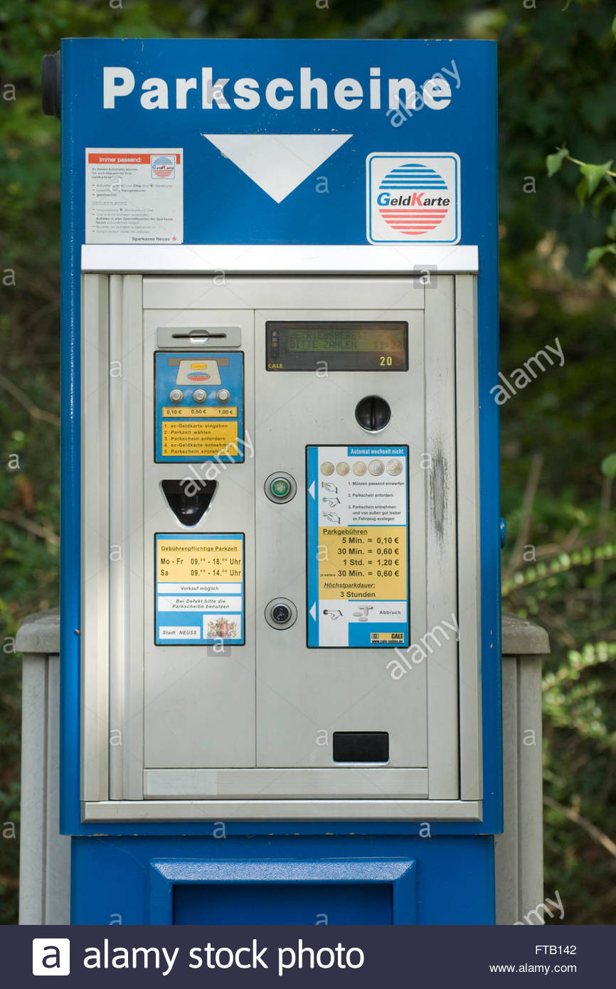
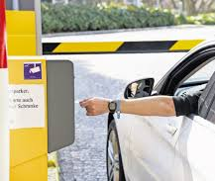
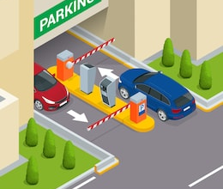
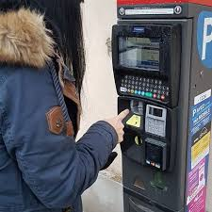

Slide 3

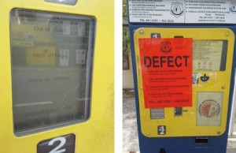
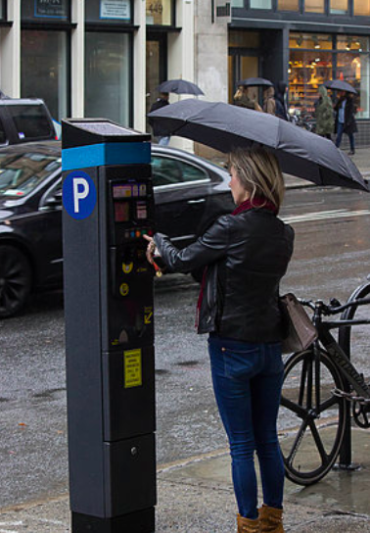
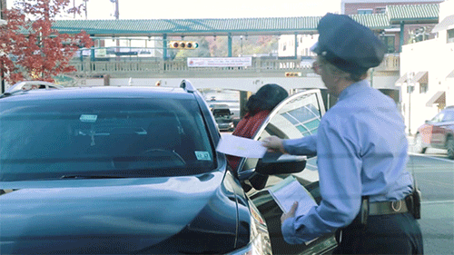

Parking

Slide 4


VALUE Proposition – Pain v/s Gain
Waste of Time
Park and Pay
Save Time
Cumbersome Process
Easy Park and Pay
Unsatisfactory service
High customer satisfaction
Not smart
Smart and simple

Slide 5




Financials for Parking industry
Total Parking Costs
Estimated cost lost for searching park places
Germany
41 Hours/ person/ year
U.S.A
17 Hours/ person/ year
UK
44 Hours/ person/ year
Germany
45.2 Bn €/ year
U.S.A
95.7 Bn $/ year
UK
31.2 Bn £/ person/ year
Germany
4.4 Bn €/ year
U.S.A
20.4 Bn $/ year
UK
6.7 Bn £/ person/ year
Germany
40.4 Bn €/ year
U.S.A
72.7 Bn $/ year
UK
23.3 Bn £/ person/ year
** Overpaid – paying for more parking time than required

Slide 6





Park and Pay Management
Park & Pay
Start park
End park
Find my car
Parking regulations
INRIX – Research partner
Park and Pay ecosystem
The minimum viable footprint

Slide 7
Parking made easy

Slide 10
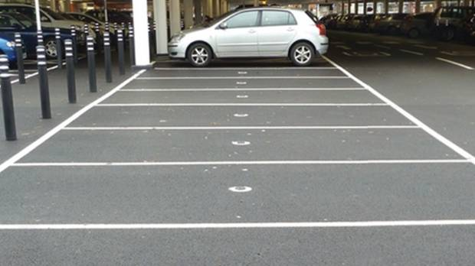


Slide 14

Park & Pay
Start park
End park
Find my car

Slide 15
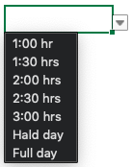

Park & Pay
Park & Pay
Park & Pay
Start park
Start time: 16:30
Start time: 16:30
Select expected time
Select expected time
End park
Find my car
Your parking ends at 18:30

Slide 16
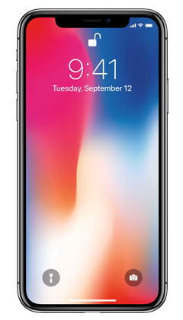
Your parking is valid only for the next 15 minutes

Slide 17
Park & Pay
Park & Pay
Park & Pay
Balance: 150 €
Start park
Start time: 16:30 hrs
Payment successful
End time: 17:45 hrs
End park
😃
Total time:1.15 hrs
Cost per hour: 4 €
Find my car
Total cost: 2.50 €
Pay

Slide 18
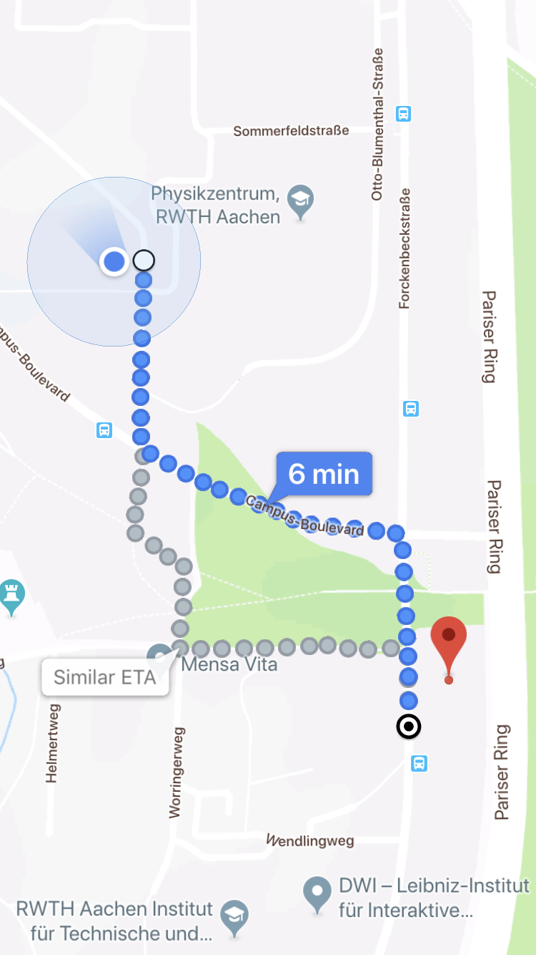


Park & Pay
Start park
End park
Find my car

Slide 19
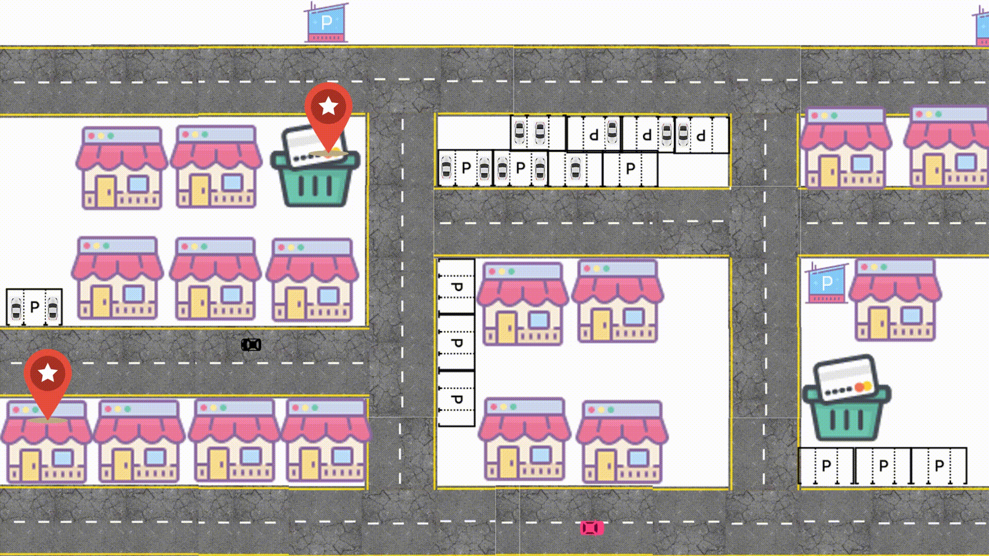
Practical Demo
Park and Pay

Slide 20
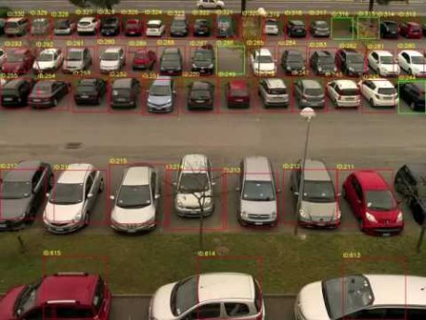
Artificial Intelligence Camera technology

Slide 21



RISKS
Co-Innovation Risks
Technological alignment with Government
Risks
Execution Risks
Traffic regulations to drive other OEMs and standardization
Co-Adoption Risks
Parallel Progress of Infrastructure

Slide 22
Parking near your destination is full please park your car in area b or area c

